Slide 1
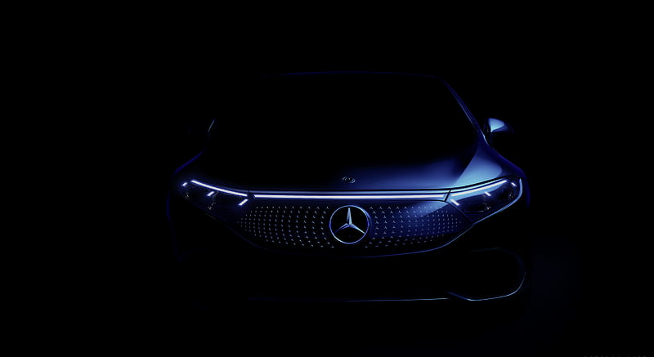

Vietnam
Car Data Insights
Our dataset provides comprehensive information on various aspects of cars, including selling price, mileage, engine specifications, and more.
Name: Moonmoon Samal
Cap-DS-05

Slide 2
Vietnam
Introduction
Dataset Summary
Key Insights
Conclusion

Slide 3

Vietnam
Dataset Summary :
Name: The name or model of the car.
Year: The manufacturing year of the car.
selling_price: The price at which the car was sold.
KM_Driven: The number of kilometers driven by the car.
Fuel: The type of fuel the car uses.
Seller_Type: The type of seller (individual, dealer, or Trustmark dealer).
Transmission: The type of transmission (manual or automatic).
0wner: The number of previous owners of the car.
Mileage: The mileage of the car in kilometers per liter.
Engine [CC]: The engine displacement in cubic centimeters (CC).
Max_Power: The maximum power output of the car's engine.
Seats: The number of seats in the car. write this ina correct way

Slide 4
Vietnam
Key Insights:
Reading the whole table
counting the total number cars present in the data set
unique fuel types in this table
Average kilometer driven by cars
Average selling price of different car models
10 car model driven the most on average
Top 10 popular car model
Numbers of cars sold by each seller type
Car with the highest mileage
Car with the lowest mileage
Cars sold by each transmission type with lower than 12000 km driven
Kilometers driven for cars sold by individual sellers compared to dealers
car models with consistently low mileage across different years

Slide 5
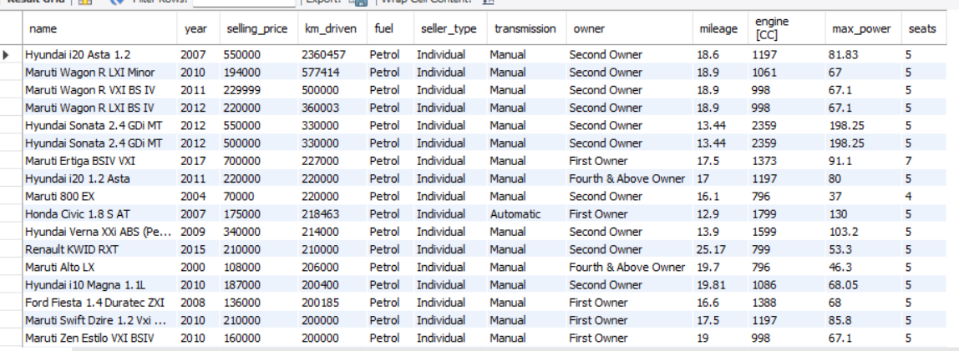
Vietnam
Reading the whole table of the Dataset:

Slide 6
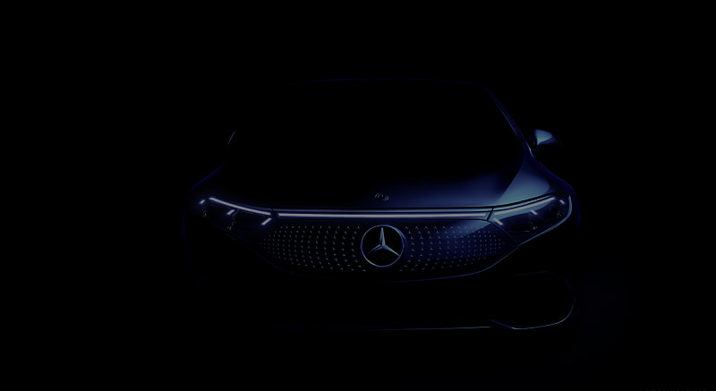

Analysis helps us understand complex data by turning it into useful information. This can help us make better decisions, identify trends, and improve things in many areas, like businesses, science, and society.
01
02
03
04
Our dataset contains information for 8,128 cars.
Cars in our data run on petrol, diesel, LPG, or CNG.
On average, these cars have traveled about 69,819 kilometers.
Cars Sold By seller type :
Dealer : 1126
Individual : 6766
Trustmark Dealer : 236
Cars sold by transmission, under 12k km :
Automatic : 304
Manual : 309
Highest mileage car :
Volvo XC90 T8 Excellence BSVI – 42 Mileage
Lowest mileage car:
Hyundai Santro Xing (Non-AC) – 0 Mileage.
Cars with more seats having average mileage
tata Winger Deluxe -Flat Roof (10.71M)- 14 seat

Slide 7

Top 10 Popular Car Model :
Maruti Swift Dzire VDi
Maruti Alto 800 LXI
Maruti Alto LXi
BMW X4 M Sport X xDrive20d
Maruti Swift VDI
Maruti Swift VDI BS IV
Maruti Swift Dzire VXi
Maruti Wagon R LXI
Maruti Alto K10 VXI
Hyundai EON Era Plus

Slide 8

Average selling price of top 5 car models :
Volvo XC90 T8 Excellence BSIV, 10000000.0000
BMW X7 xDrive30d DPE, 7200000.0000
Audi A6 35 TFSI Matrix, 6223000.0000
Mercedes-Benz S-Class S 350 CDI, 5962500.0000
BMW 6 Series GT 630d Luxury Line, 5860000.0000

Slide 9

10 car model driven the most on average :
Toyota Innova 2.5 EV Diesel PS 7 Seater BSIII, 500000.0000
Toyota Innova 2.5 VX (Diesel) 7 Seater BS IV, 426000.0000
Mahindra Bolero DI Non AC BS III, 300000.0000
Toyota Qualis FS B3, 290000.0000
Tata Sumo Gold GX BS III, 270000.0000
Chevrolet Tavera Neo LT-L - 9 seats BSIII, 265000.0000
Hyundai i20 Asta 1.2, 260325.6667
Tata New Safari DICOR 2.2 EX 4x4 BS IV, 250000.0000
Chevrolet Tavera B2 8 Seats BSIII, 250000.0000
Toyota Qualis FS F7, 250000.0000

Slide 10

Kilometers driven for cars sold by individual sellers compared to dealers :
( Seller_type, Min_km, Max_km, Avg_km)
Dealer 1303, 221889, 44383.9805
Individual 1, 2360457, 75013.8077
Trustmark Dealer 2286, 79328, 42259.3178

Slide 11

car models with consistently low mileage across different years:
(name, year, mileage)
Ambassador CLASSIC 1500 DSL AC, 2000, 12.8
Ambassador Classic 2000 DSZ AC PS, 1994, 12.8
Ambassador Grand 1500 DSZ BS III, 2008, 12.8
Ambassador Grand 2000 DSZ PW CL, 2008, 13.5
Audi A3 40 TFSI Premium, 2017, 16.6
Audi A4 1.8 TFSI, 2010, 12.3
Audi A4 2.0 TDI, 2014, 16.55
Audi A4 2.0 TDI, 2014, 16.55
Audi A4 2.0 TDI 177Bhp Premium Plus, 2013, 17.11
Audi A4 35 TDI Premium Plus, 2015, 18.25

Slide 12
Conclusion
Fuel types: We saw a mix of petrol, LPG, diesel, and CNG cars. ⛽️
Mileage: The average car has been driven about 69819.5108 kilometers.
Popular models: Maruti Swift and Alto, BMW are top sellers!
Selling prices: They vary depending on the car, with some brands costing more.
Sellers: Individual car seller sold the most cars, followed by dealers.

